Slide 1
Chapter 12
The Polling case study

Slide 2
Objectives
Applied
Given the code in any cell or group of cells in the Polling case study, describe what it does.
Knowledge
Describe the use of monthly bins when you’re analyzing polling data.
Describe the use of swing state data and polling gaps in an analysis of presidential polling data.

Slide 3
Import Pandas and Seaborn
import pandas as pd
import seaborn as sns

Slide 4
Get the data
Set the path and the filename
poll_path = \
'http://projects.fivethirtyeight.com/general-model/'
filename = 'president_general_polls_2016.csv'
Download the CSV file
from urllib import request
request.urlretrieve(poll_path+filename, filename=filename)
Read the CSV file into a DataFrame
polls = pd.read_csv(filename)

Slide 5
Display the data
Display the DataFrame
polls
Display the first five rows
polls.head()
Display the last five rows
polls.tail()

Slide 6
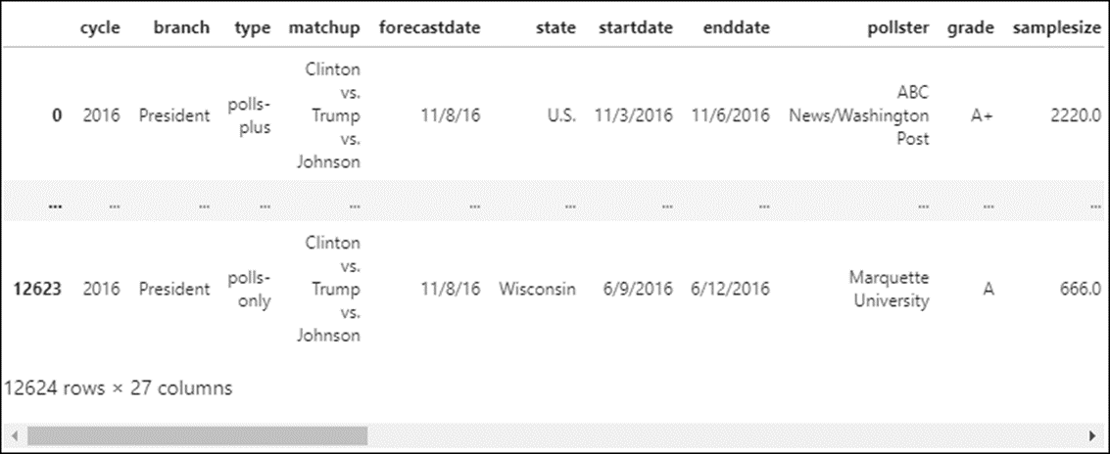
Display the data (continued)
Display all columns but just the first and last row
with pd.option_context(
'display.max_rows', 2,
'display.max_columns', None):
display(polls)

Slide 7
Examine the data with the info() method
polls.info(memory_usage='deep')
==========================================
<class 'pandas.core.frame.DataFrame'>
RangeIndex: 12624 entries, 0 to 12623
Data columns (total 27 columns):
cycle 12624 non-null int64
branch 12624 non-null object
type 12624 non-null object
matchup 12624 non-null object
forecastdate 12624 non-null object
state 12624 non-null object
startdate 12624 non-null object
enddate 12624 non-null object
pollster 12624 non-null object
grade 11337 non-null object
samplesize 12621 non-null float64
population 12624 non-null object
poll_wt 12624 non-null float64
rawpoll_clinton 12624 non-null float64
rawpoll_trump 12624 non-null float64

Slide 8
Examine the data with the info() method (cont.)
rawpoll_johnson 8397 non-null float64
rawpoll_mcmullin 90 non-null float64
adjpoll_clinton 12624 non-null float64
adjpoll_trump 12624 non-null float64
adjpoll_johnson 8397 non-null float64
adjpoll_mcmullin 90 non-null float64
multiversions 36 non-null object
url 12621 non-null object
poll_id 12624 non-null int64
question_id 12624 non-null int64
createddate 12624 non-null object
timestamp 12624 non-null object
dtypes: float64(10), int64(3), object(14)
memory usage: 12.9 MB

Slide 9
Examine the data with the nunique() method
polls.nunique(dropna=False)
===================================
cycle 1
branch 1
type 3
matchup 1
forecastdate 1
state 57
startdate 352
enddate 345
pollster 196
grade 11
samplesize 1767
population 4
poll_wt 4399
rawpoll_clinton 1312
rawpoll_trump 1385
rawpoll_johnson 585
rawpoll_mcmullin 17

Slide 10
Examine the data with nunique() (cont.)
adjpoll_clinton 12569
adjpoll_trump 12582
adjpoll_johnson 6630
adjpoll_mcmullin 58
multiversions 2
url 1305
poll_id 4208
question_id 4208
createddate 222
timestamp 3
dtype: int64

Slide 11
Examine the data with the unique() method (partial results)
polls.apply(pd.unique)
=====================================================================
cycle [2016]
branch [President]
type [polls-plus, now-cast, polls-only]
matchup [Clinton vs. Trump vs. Johnson]
forecastdate [11/8/16]
state [U.S., New Mexico, Virginia, Iowa, Wisconsin, ...
...
population [lv, rv, a, v]
multiversions [nan, *]

Slide 12
Drop unnecessary columns and rows
Drop columns with only one value
polls.drop(columns=['cycle','branch','matchup','forecastdate'],
inplace=True)
Keep only the rows with “now-cast” in the type column and drop that column
polls = polls.query('type == "now-cast"')
polls.drop(columns='type', inplace=True)
Keep only the rows that have ‘lv’ or ‘rv’ in the population column
polls.query('population !="lv" & population != "rv"') # just 63 rows
polls = polls.query('population in ["lv","rv"]')
Find unnecessary index columns and then drop them
polls.loc[:, polls.nunique() == polls.shape[0]] # display columns
polls.drop(columns=['poll_id','question_id'], inplace=True)

Slide 13
Drop unnecessary columns and rows (cont.)
Find columns that start with ‘adjpoll’ and then drop them
polls.loc[:, polls.columns.str.startswith('adjpoll')]
polls = polls.loc[:, ~polls.columns.str.startswith('adjpoll')]
Drop the columns for Johnson and McMullen
polls.drop(columns=['rawpoll_johnson','rawpoll_mcmullin'],
inplace=True)
Check the non-null rows in the multiversions column and drop that column
polls.loc[polls.multiversions.notnull()]
polls.drop(columns='multiversions')
Drop 3 more columns
polls.drop(columns=['createddate','timestamp','url'], inplace=True)
polls.head()

Slide 14
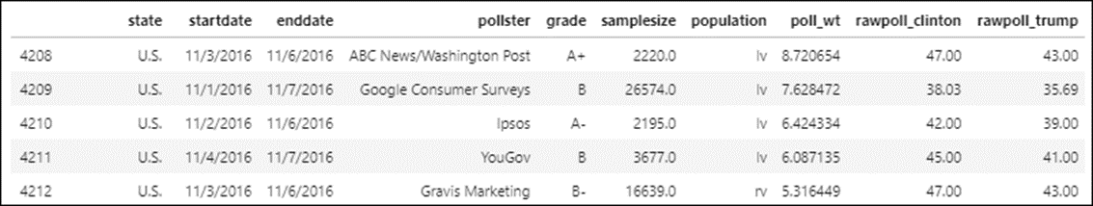
The cleaned DataFrame

Slide 15
Rename voting columns
polls.rename(columns={'rawpoll_clinton':'clinton_pct',
'rawpoll_trump':'trump_pct'},
inplace=True)

Slide 16
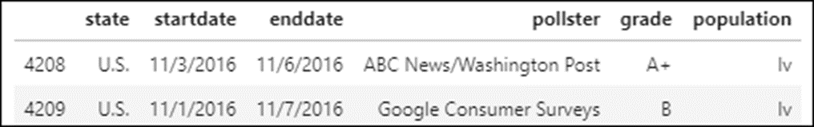
Fix object types that should be numeric or datetime objects
List the object types
polls.select_dtypes('object').head(2)
Convert the object types that are dates to datetime objects
date_cols = ['startdate','enddate']
polls[date_cols] = polls[date_cols].apply(pd.to_datetime)

Slide 17
Fix the data for the state column
List the unique values in the state column
polls.state.unique() # this lists values like "Maine CD-1"
# and "Maine CD-2"
List all the state values that contain “CD-”
polls[polls.state.str.contains('CD-')]['state']
Drop those rows after you find out that CD stands for Congressional District
polls = polls.loc[~polls.state.str.contains('CD-')]

Slide 18
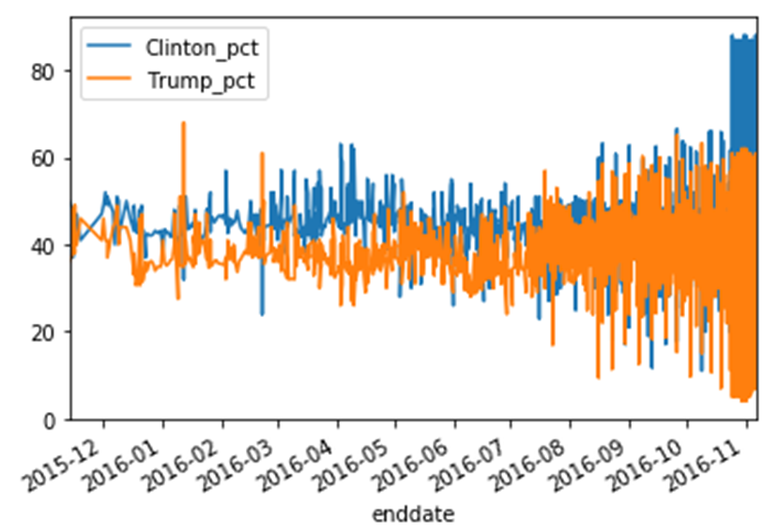
Take an early plot with Pandas
polls.plot.line(x='enddate', y=['clinton_pct','trump_pct'])

Slide 19
Save the DataFrame as a pickle file
polls.to_pickle('polls_clean.pkl')

Slide 20
Add columns for grouping and filtering
Add a voter_type column and drop the population column
polls['voter_type'] = polls.population.replace(
{'lv':'likely','rv':'registered'})
polls.drop(columns='population', inplace=True)
Add a gap column for the gap between the Clinton and Trump percents
polls['gap'] = polls.clinton_pct - polls.trump_pct
Add a state_gap summary column that contains the gap for each state
polls['state_gap'] = polls.groupby('state').gap.transform(func='mean')
Add a swing column that identifies states with a less than a 7 percent gap
polls['swing'] = (polls.state != "U.S.") & (abs(polls.state_gap) < 7)

Slide 21
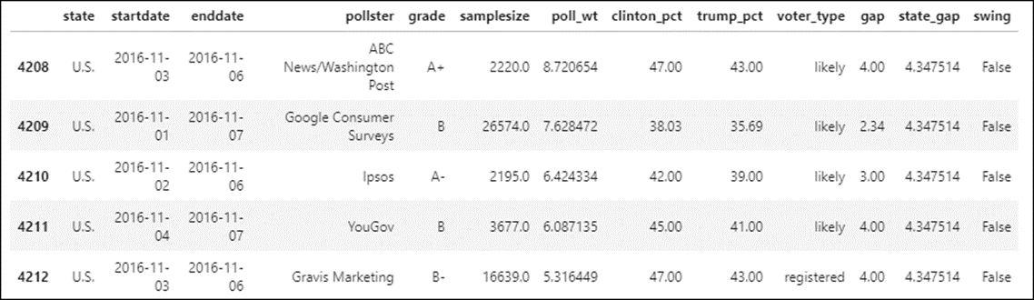
The DataFrame with grouping and filtering

Slide 22
Two ways to display the rows for swing states
With the query() method
polls.query('swing == True')
With the loc accessor
polls.loc[polls.swing == True]

Slide 23
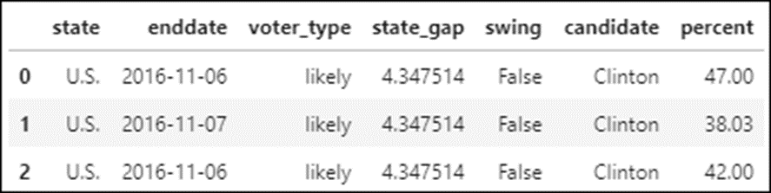
Create a new DataFrame in long form
Melt the data to add two columns
polls_long = polls.melt(
id_vars=['state','enddate','voter_type','state_gap','swing'],
value_vars=['clinton_pct','trump_pct'],
var_name='candidate',
value_name='percent')
Clean up the strings in the candidate column
polls_long['candidate'] = \
polls_long.candidate.str.replace('_pct','').str.title()

Slide 24
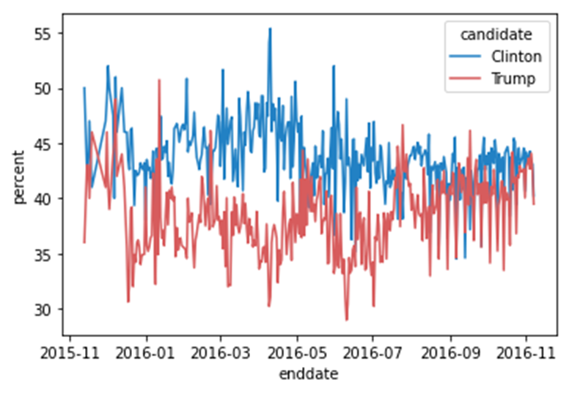
Take an early plot of the long data with Seaborn
colors = ['#2281c4','#d75c5d'] # blue and red
sns.set_palette(sns.color_palette(colors)) # change color
# palette
sns.lineplot(data=polls_long, x='enddate', y='percent',
hue='candidate', ci=None)

Slide 25
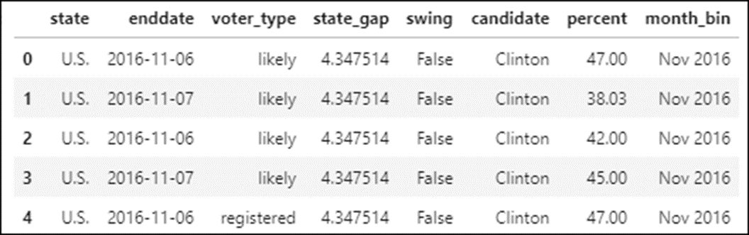
Add monthly bins to the DataFrame
import datetime as dt
dates = pd.date_range('10/01/2015', '12/01/2016', freq='M')
bin_labels = [dt.datetime.strftime(x, '%b %Y') for x in dates[1:]]
monthly_bins = pd.cut(x=polls_long.enddate, bins=dates,
labels=bin_labels)
polls_long['month_bin'] = monthly_bins
polls_long.head()

Slide 26
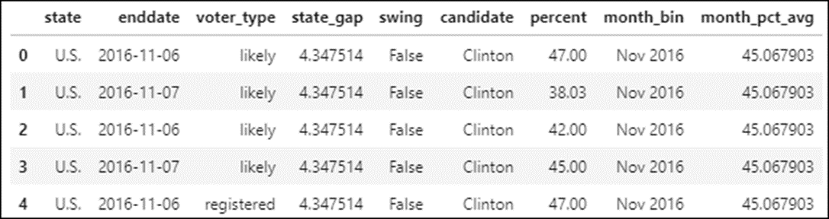
Add an average percent column for each month
polls_long['month_pct_avg'] = polls_long.groupby(
['candidate','state','month_bin']).percent.transform(func='mean')
polls_long.head()

Slide 27
Save the wide and long DataFrames as pickle files
polls.to_pickle('polls_prepared.pkl')
polls_long.to_pickle('polls_long.pkl')

Slide 28
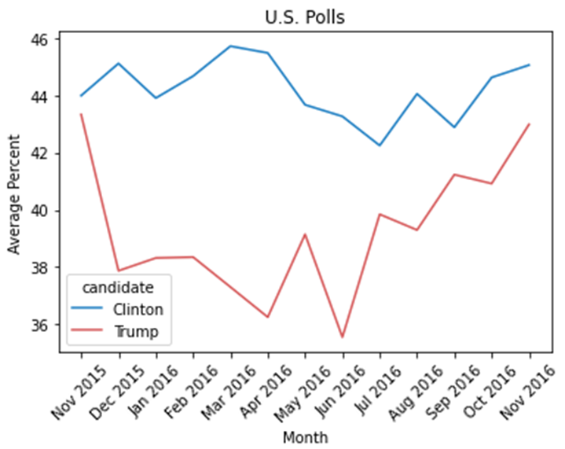
Plot the national polls
ax = sns.lineplot(data=polls_long.query('state == "U.S."'),
x='month_bin', y='month_pct_avg', hue='candidate', ci=None)
ax.set(title='U.S. Polls', xlabel='Month', ylabel='Average Percent')
ax.tick_params('x', labelrotation=45)

Slide 29
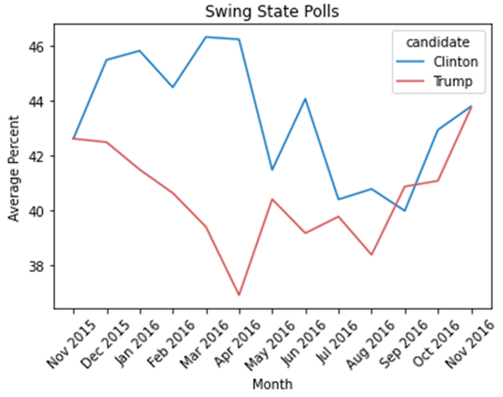
Plot the swing state polls
ax = sns.lineplot(data=polls_long.query('swing == True'),
x='month_bin', y='month_pct_avg',
hue='candidate', ci=None)
ax.set(title='Swing State Polls', xlabel='Month',
ylabel='Average Percent')
ax.tick_params('x', labelrotation=45)

Slide 30
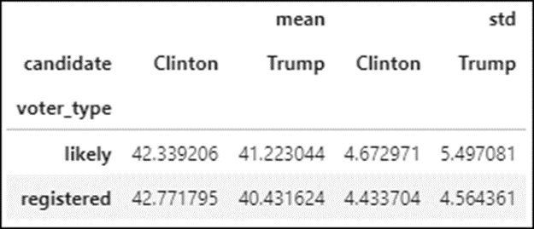
Plot the swing state results by voter type
Group the data by voter_type and candidate
polls_grouped = polls_long.query('swing == True') \
.groupby(['voter_type','candidate'])
Look at the mean and standard deviation of the percent column
polls_grouped.percent.agg(['mean','std']).unstack(
level='candidate').head()

Slide 31
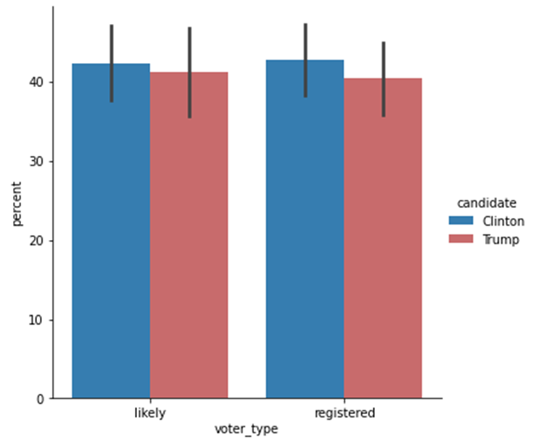
Plot the swing state results by voter type (cont.)
Plot the mean and standard deviation of the percent column for each candidate
sns.catplot(data=polls_long.query('swing == True'), kind='bar',
x='voter_type', y='percent', hue='candidate', ci='sd')

Slide 32
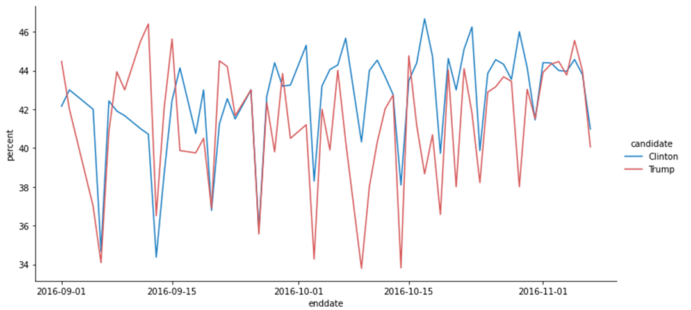
Plot the last two months of polling for likely voters in all swing states
g = sns.relplot(data=polls_long.query('voter_type == "likely" \
& swing == True & enddate >= "2016-09"'),
kind='line', x='enddate', y='percent', hue='candidate', ci=None,
aspect=2)

Slide 33
Plot the last two months of polling for likely voters in selected states
sns.relplot(data=polls_long.query('state in ["Michigan","Florida"] \
& voter_type == "likely" & enddate >= "2016-09"'),
kind='line', x='enddate', y='percent', hue='candidate', ci=None,
col='state', col_wrap=1, aspect=2)

Slide 34
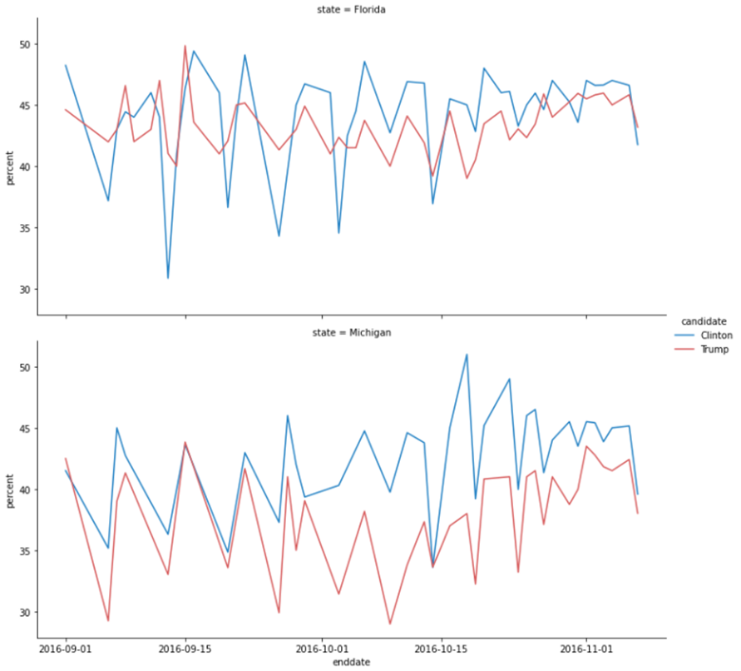
Plot the last two months of polling (continued)

Slide 35
Plot the gap changes in selected states
# restore the default color palette
sns.set_palette(sns.color_palette('tab10'))
# create the plot
g = sns.relplot(data=polls.query('state==["Michigan", "Florida"] \
& enddate > "2016-09"'),
kind="line", x='enddate', y='gap', ci=None,
col='state', col_wrap=2)
# format the plot
g.fig.suptitle('Percent Gap for Key Swing States', y=1.025)
g.set(xlabel="Polling End Date", ylabel="Percent Gap: Clinton - Trump")
for ax in g.axes.flat:
ax.tick_params('x', labelrotation=45)
ax.axhline(0, color='red')

Slide 36
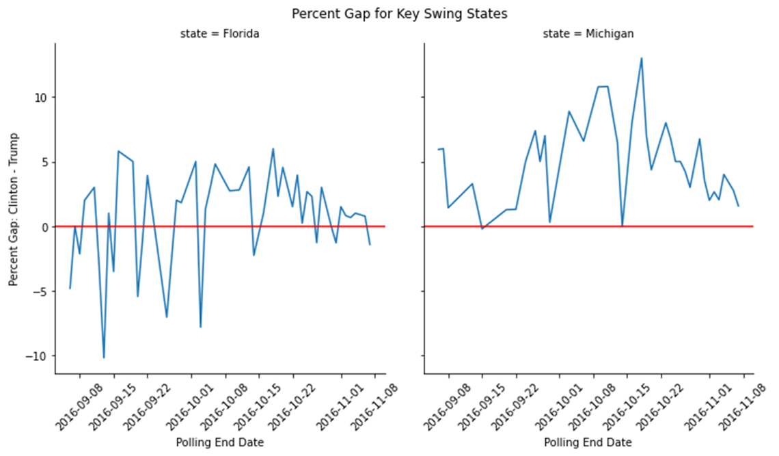
Plot the gap changes in selected states (cont.)

Slide 37
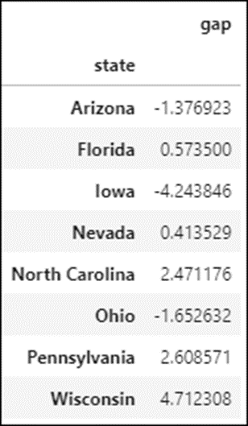
Prepare the gap data for the last week of polling
polls_gap = polls.query('state==["Wisconsin", "Arizona", \
"Pennsylvania","Nevada","Iowa","Florida","North Carolina","Ohio"] \
& enddate > "2016-11-01"')[['state','gap']]
polls_gap = polls_gap.groupby('state').mean()
polls_gap

Slide 38
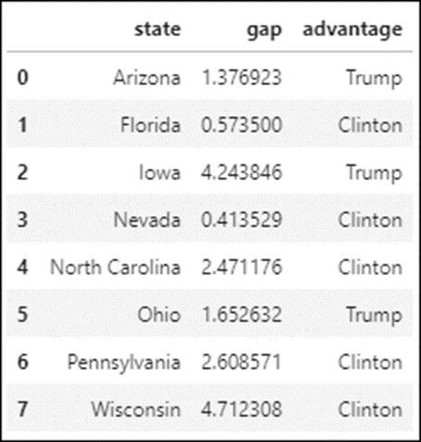
Prepare the gap data for the last week (continued)
polls_gap['advantage'] = polls_gap.apply(
lambda row: 'Clinton' if row.gap > 0 else 'Trump', axis=1)
polls_gap['gap'] = abs(polls_gap.gap)
polls_gap = polls_gap.reset_index()
polls_gap

Slide 39
Plot the gap data for the last week of polling
# set custom color palette
colors = ['#d75c5d','#2281c4'] # red and blue
sns.set_palette(sns.color_palette(colors))
# create the plot
g = sns.catplot(data=polls_gap, x='state', y='gap', kind='bar',
hue='advantage', dodge=False)
# format the plot
for ax in g.axes.flat:
ax.tick_params('x', labelrotation=45)
ax.set(title='Gap Percent One Week Before Election Day',
xlabel='Key Swing States',
ylabel='Percent')
# save the plot
g.fig.subplots_adjust(top=0.90) # adjust the top to fit the title
g.fig.subplots_adjust(bottom=0.35) # adjust the bottom to fix the y
# labels
g.fig.savefig('swing_state_gap_bar.png')

Slide 40
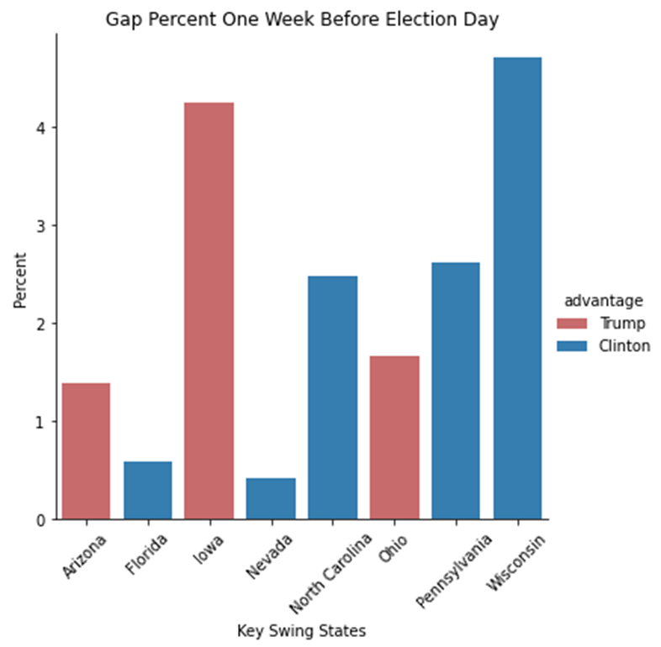
Plot the gap data for the last week (continued)

Slide 41
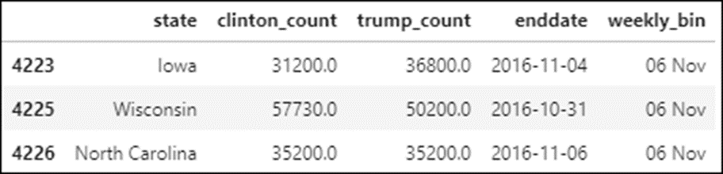
Prepare the weekly gap data for the swing states
Get the columns and rows for this plot
polls_heat = polls[['state','enddate','samplesize',
'clinton_pct','trump_pct','swing']].copy()
polls_heat = polls_heat.query('swing == True')
# add two columns
polls_heat['clinton_count'] = polls_heat.samplesize * polls_heat.clinton_pct
polls_heat['trump_count'] = polls_heat.samplesize * polls_heat.trump_pct
# select only the necessary columns
polls_heat = polls_heat[['state','clinton_count','trump_count','enddate']]
# create and add the weekly bins
dates = pd.date_range('09/01/2016', '11/13/2016', freq='w')
bin_labels = [dt.datetime.strftime(x, '%d %b') for x in dates[1:]]
weekly_bins = pd.cut(x=polls_heat.enddate, bins=dates, labels=bin_labels)
polls_heat['weekly_bin'] = weekly_bins
polls_heat.head(3)

Slide 42
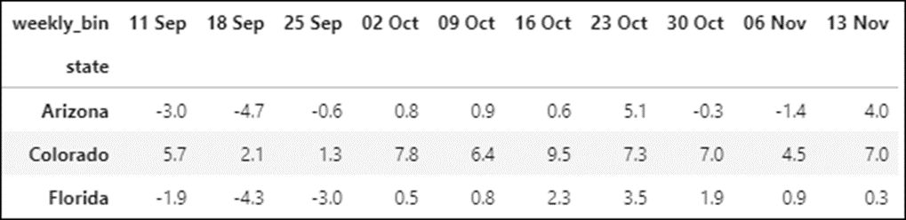
Prepare the weekly gap data for the swing states (continued)
Calculate the weekly gap
# group and sum the weekly counts by state
polls_heat = polls_heat.groupby(['state','weekly_bin']).sum().fillna(0)
# add the gap column and remove all other columns
polls_heat['gap'] = ((polls_heat.clinton_count - polls_heat.trump_count) /
(polls_heat.clinton_count + polls_heat.trump_count)) * 100
polls_heat = polls_heat[['gap']].fillna(0).round(1)
# unstack the weekly bin level and drop level 0 (gap)
polls_heat = polls_heat.unstack(level='weekly_bin')
polls_heat = polls_heat.droplevel(level=0, axis=1)
polls_heat.head(3)

Slide 43
Plot the weekly gap data for swing states
# use matplotlib to set the figure size
import matplotlib.pyplot as plt
fig, ax = plt.subplots(figsize=(10,7.5))
# create the plot
sns.heatmap(polls_heat, cmap=['#d75c5d','#2281c4'], center=0,
annot=True, linewidths=0.01, linecolor='black', cbar=False)
# format the plot
ax.set(title='Gap Percent For Swing States By Week',
xlabel='Week', ylabel='State')
# save the figure
fig.savefig('swing_state_gap_heat_map.png')

Slide 44
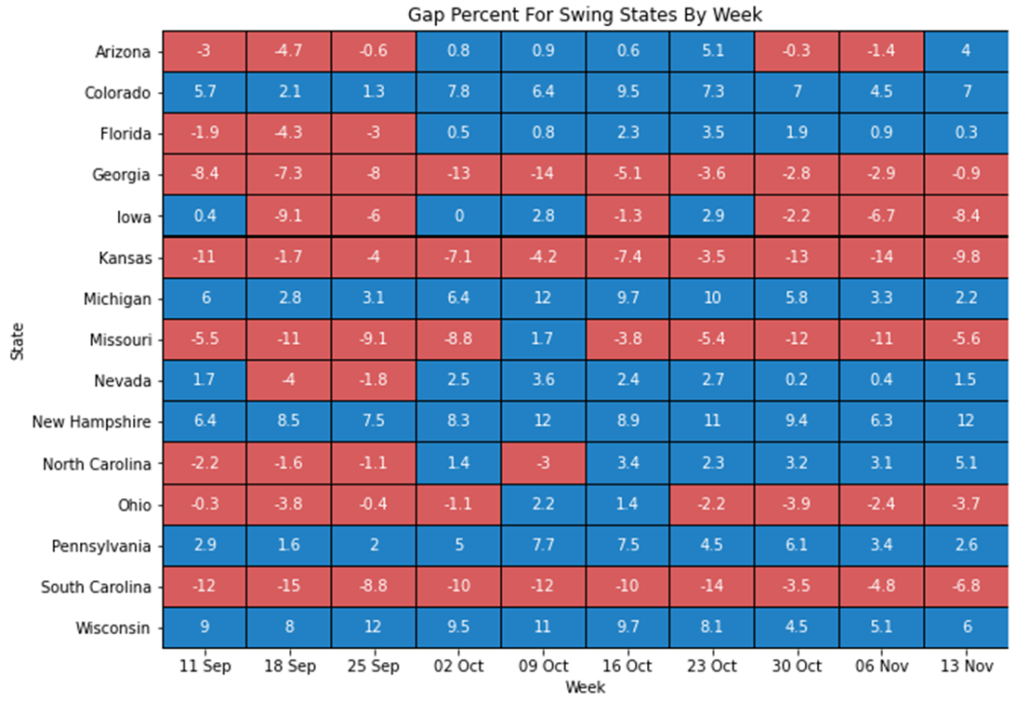
Plot the weekly gap data for swing states (cont.)

